Slide 2
Antra SEP Program
Hello World
Core Java Training 4

Slide 3
Day 4 Training Schedule
Exception Handling
Utility Classes
Blocks
Thread.

Slide 4
Exception Handling
When a program runs into a runtime error, the program terminates abnormally. How can you handle the runtime error so that the program can continue to run or terminate gracefully?
Exception hierarchy:
Throwable acts as a root for exception hierarchy.
Throwable class contains the following two child classes.
Exception: Most of the cases exceptions are caused by our program and these are recoverable.
Error: Most of the cases errors are not caused by our program these are due to lack of system resources and these are non recoverable.

Slide 5
Exception Handling

Slide 6
Exception Handling
System errors are thrown by JVM and represented in the Error class. The Error class describes internal system errors. Such errors rarely occur. If one does, there is little you can do beyond notifying the user and trying to terminate the program gracefully.

Slide 7
Exception Handling
Exception describes errors caused by your program and external circumstances. These errors can be caught and handled by your program.

Slide 8
Runtime Exceptions
RuntimeException is caused by programming errors, such as bad casting, accessing an out-of-bounds array, and numeric errors.

Slide 9
Checked Exceptions vs. Unchecked Exceptions
RuntimeException, Error and their subclasses are known as unchecked exceptions. All other exceptions are known as checked exceptions, meaning that the compiler forces the programmer to check and deal with the exceptions.
Compiler can check the checked exception. So it would be always be handled in the code.
If the developer doesn't handle the unchecked exception in the code, it will cause program ternimation abnormally.
Ex, System.out.print(1/0);

Slide 10
Unchecked Exceptions
In most cases, unchecked exceptions reflect programming logic errors that are not recoverable.
For example, a NullPointerException is thrown if you access an object through a reference variable before an object is assigned to it;
an IndexOutOfBoundsException is thrown if you access an element in an array outside the bounds of the array. These are the logic errors that should be corrected in the program.
Unchecked exceptions can occur anywhere in the program. To avoid cumbersome overuse of try-catch blocks, Java does not mandate you to write code to catch unchecked exceptions.

Slide 11
Unchecked Exceptions

Slide 12

Declaring, Throwing, and Catching Exceptions
Use try-catch-finally to handle the exceptions.
Use throws keyword to declaring a method.
Use throw keyword to throw an exception.

Slide 13
Declaring Exceptions
Every method must state the types of checked exceptions it might throw. This is known as declaring exceptions.
public void myMethod() throws IOException
public void myMethod() throws IOException, OtherException

Slide 14
Throwing Exceptions
When the program detects an error, the program can create an instance of an appropriate exception type and throw it. This is known as throwing an exception. Here is an example,
throw new TheException();
TheException ex = new TheException();
throw ex;

Slide 15
Throwing Exceptions Example
/** Set a new radius */
public void setRadius(double newRadius)
throws IllegalArgumentException {
if (newRadius >= 0)
radius = newRadius;
else
throw new IllegalArgumentException(
"Radius cannot be negative");
}

Slide 16
Catching Exceptions
try {
statements; // Statements that may throw exceptions
}
catch (Exception1 exVar1) {
handler for exception1;
}
catch (Exception2 exVar2) {
handler for exception2;
}
...
catch (ExceptionN exVar3) {
handler for exceptionN;
}

Slide 17
Catching Exceptions

Slide 18
Rethrowing Exceptions
try {
statements;
}
catch(TheException ex) {
perform operations before exits;
throw ex;
}

Slide 19
The finally Clause
try {
statements;
}
catch(TheException ex) {
handling ex;
}
finally {
finalStatements;
}

Slide 20
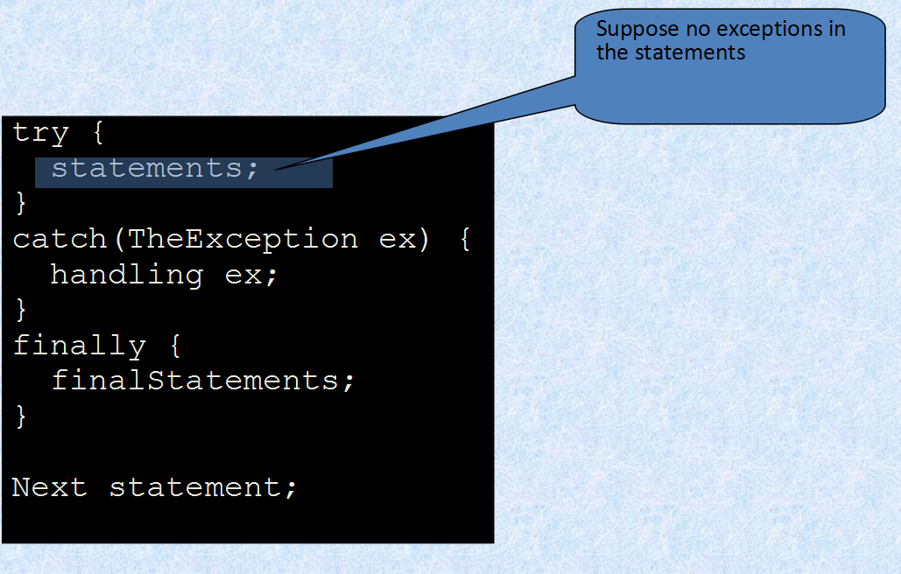
Trace a Program Execution

Slide 21
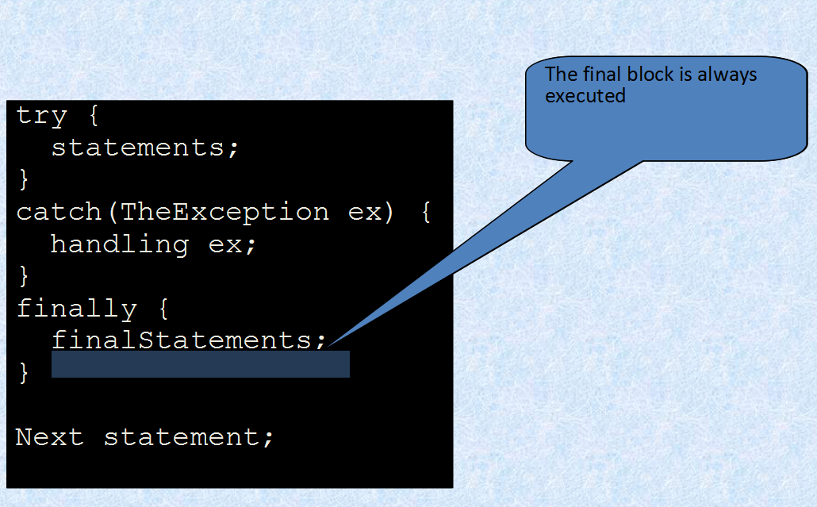
Trace a Program Execution

Slide 22
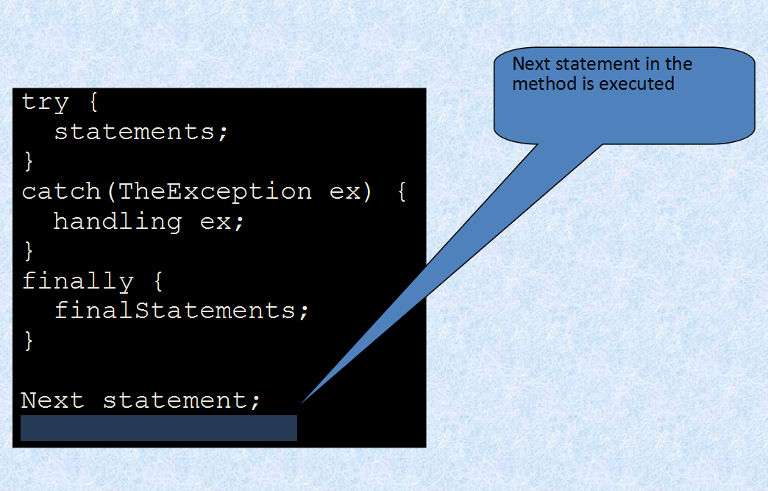

Slide 23
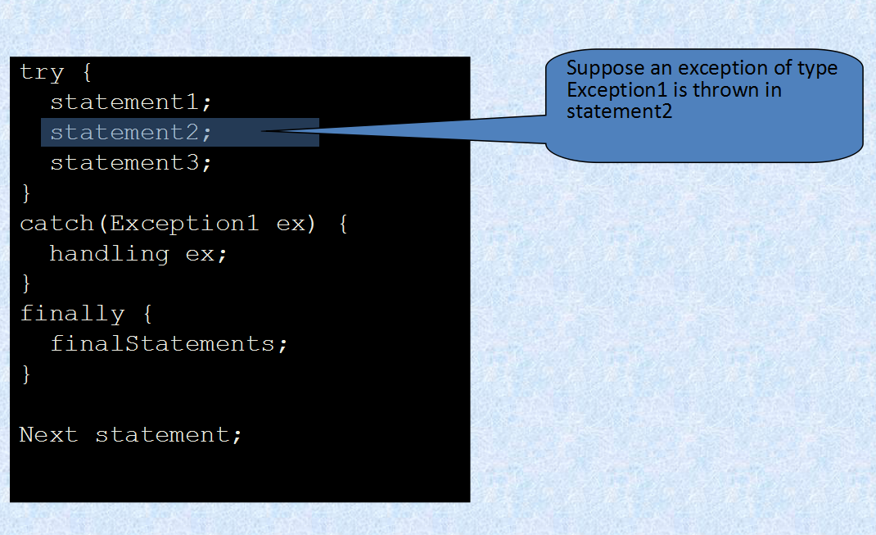
Ex 2

Slide 24
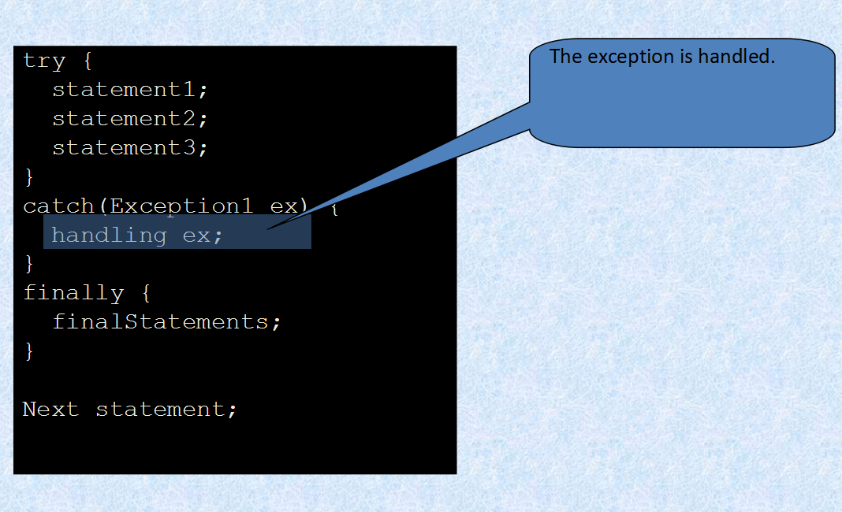

Slide 25
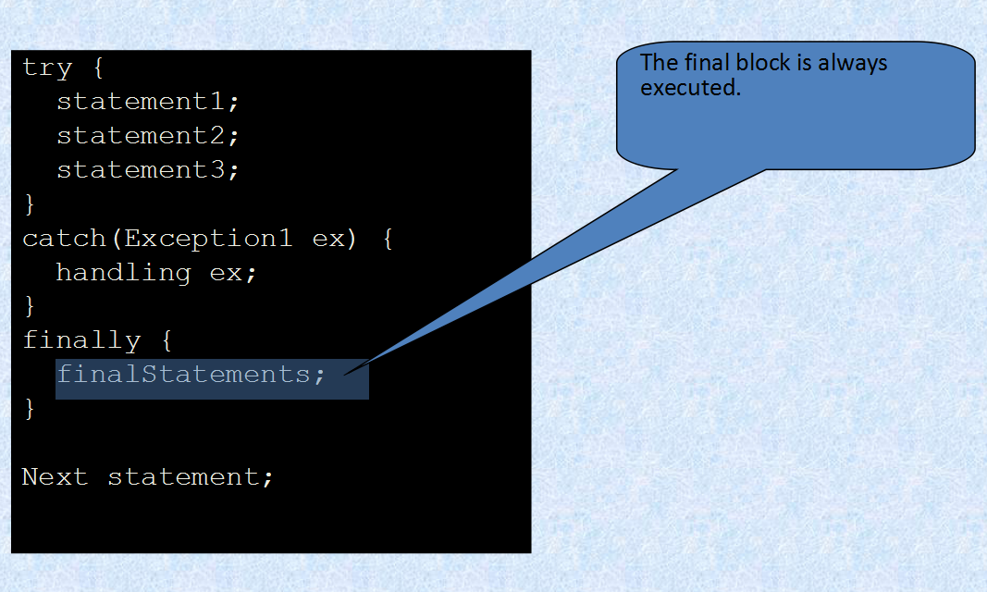

Slide 26
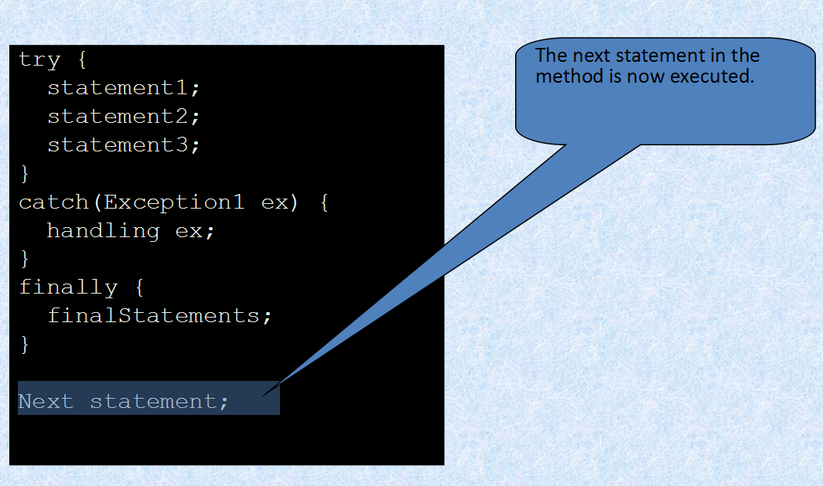

Slide 27
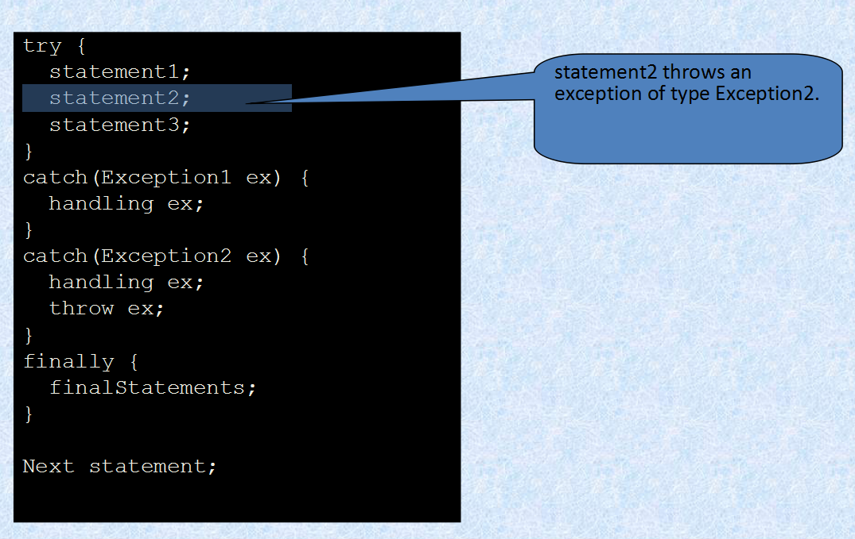
Ex 3

Slide 28
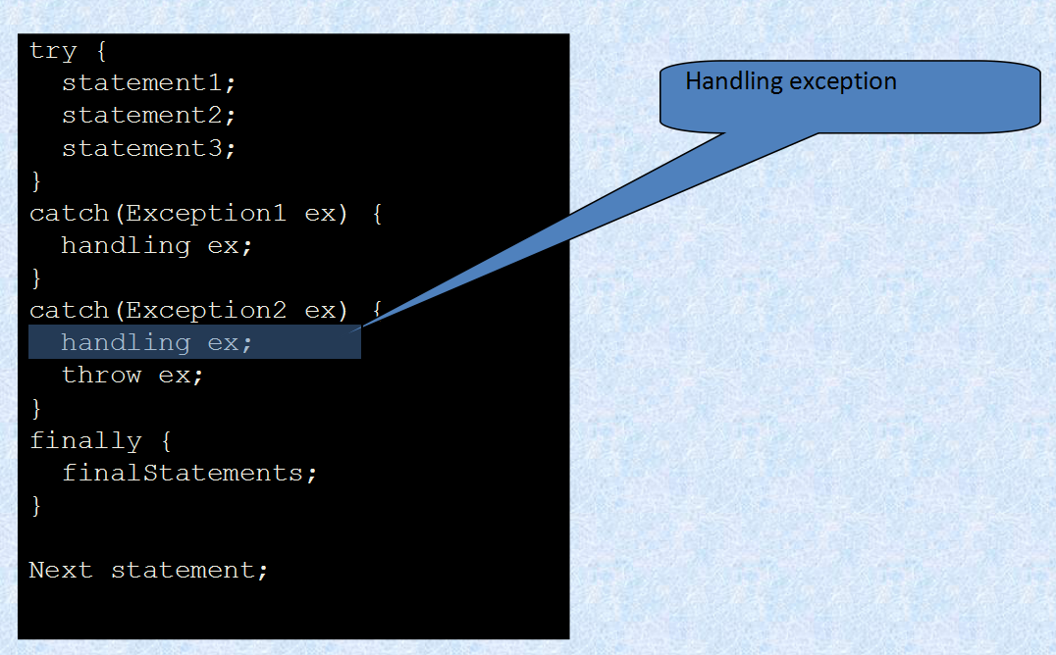

Slide 29
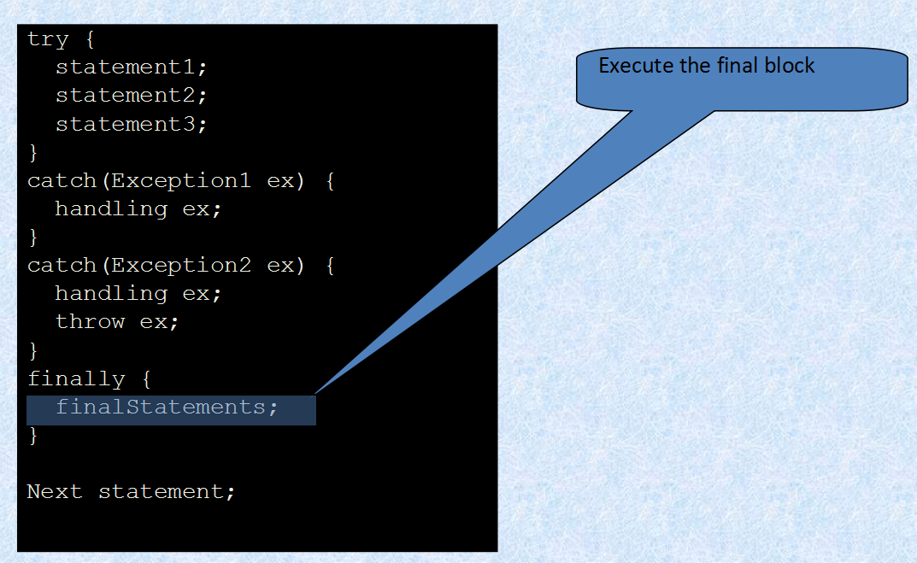

Slide 30
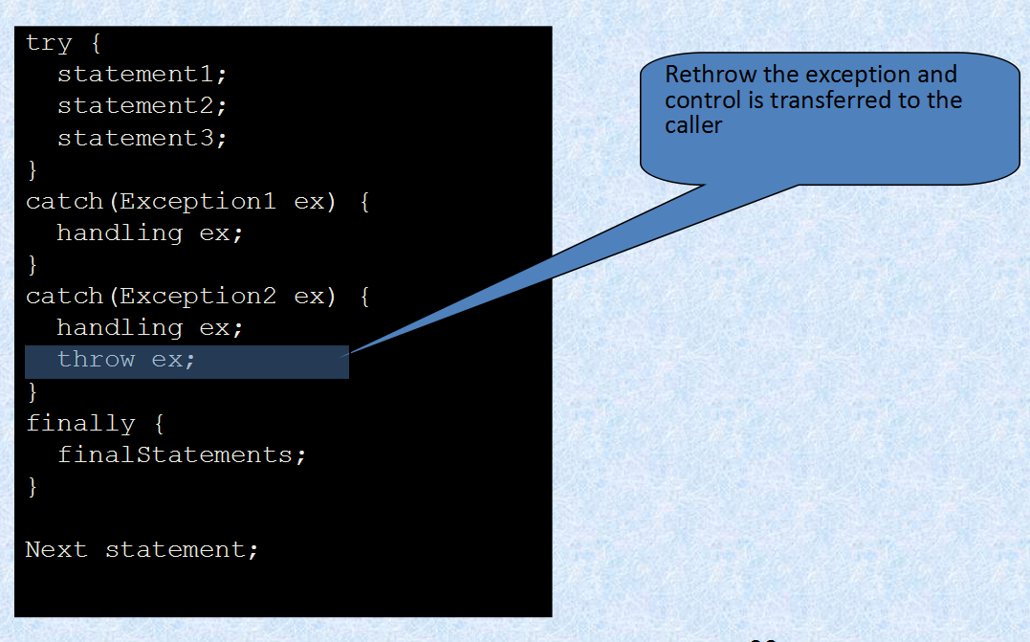

Slide 31
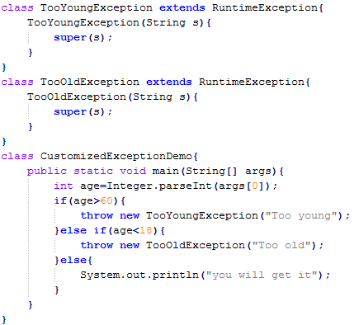
Customized Exception
Sometimes we can create our own exception to meet our programming requirements. Such type of exceptions are called customized exceptions (user defined exceptions).

Slide 32
Exception Summary
making programs easier to read and to modify
exception handling usually requires more time and resources
You should use it to deal with unexpected error conditions. Do not use it to deal with simple, expected situations. For example, the following code
try {
System.out.println(refVar.toString());
}
catch (NullPointerException ex) {
System.out.println("refVar is null");
}

Slide 33
Utility Classes
The File class is intended to provide an abstraction that deals with most of the machine-dependent complexities of files and path names in a machine-independent fashion. The filename is a string. The File class is a wrapper class for the file name and its directory path.
The class Date represents a specific instant in time, with millisecond precision.
The Calendar class is an abstract class that provides methods for converting between a specific instant in time and a set of calendar fields such as YEAR, MONTH, DAY_OF_MONTH, HOUR, and so on, and for manipulating the calendar fields, such as getting the date of the next week.

Slide 34
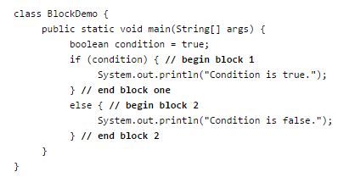
Blocks
A block is a group of zero or more statements between balanced braces and can be used anywhere a single statement is allowed.
Variables defined inside a block have the scope inside the block.

Slide 35
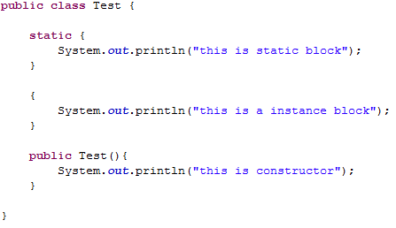
Static Block
A static initialization block is a normal block of code enclosed in braces, { }, and preceded by the static keyword.

Slide 36
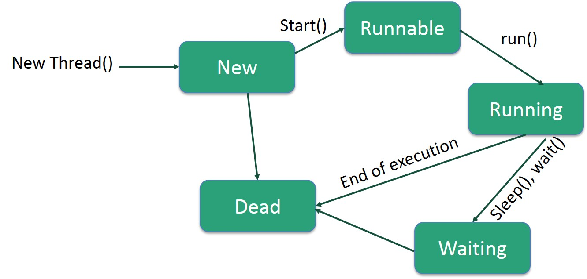
Thread
Thread vs Process
A process has a self-contained execution environment. A process generally has a complete, private set of basic run-time resources.
Threads are lightweight processes; they share the same address space.
Advantages: Maximize CPU utilization, better user experience, perform multiple tasks simultaneously, etc.

Slide 37
Thread
Thread Priorities: Every Java thread has a priority that helps the operating system determine the order in which threads are scheduled.
Java thread has Thread priority from 1(MIN_PRIORITY) to 10(MAX_PRIORITY).
In most cases, thread scheduler schedules the threads according to their priority. But it is not guaranteed because it depends on JVM specification that which scheduling it chooses.

Slide 38
Thread
There are mainly two ways to create a thread:
Implement Runnable interface
Extends Thread class
Join(), isAlive(),wait(), notify(), notifyAll(), interrupt(), yeld()

Slide 39
Thanks!

